Slide 1
CSR Annual Action Plan for FY 2026-27

Slide 2

CSR Annual Action Plan: FY 2026-27
S. No. | Location | Project Description | No. of Beneficiaries~ | Budget (mINR)
1 | Parwanoo | In partnership with HPSACS, provide comprehensive HIV/ AIDS related services to transport sector workers and migrant population | 25,000 | 2.0
2 |  | In partnership with National Health Mission provide reproductive and child health services to urban poor community | 48,000 | 1.3
3 |  | Provide ESI Hospital, Parwanoo a 12 Channel ECG Machine for emergency * | 22,000 | 0.1
4 | Gurugram | Medhavi Scholarship- Support 13 existing female students and 10 new recruits to pursue Dip. Engg. at Govt. Polytechnic, Manesar | 23 | 1.7
5 |  | Skill 120 unskilled youth as 2 Wheeler Service Assistant/ 2 W Service Technician and upgrade existing training facilities for EV training | 120 | 2.8
6 |  | Skill 120 unskilled youth as. Asst. Plumber/ General Plumber | 120 | 1.8
7 |  | Construction of Pedestrian Walkway at Behrampur Road and Refurbishment of Foot-over Bridge (subject to receipt of approval by appropriate Department) * | General Public | 5.0
8 | Pune (Pirangut) | Promotion of Micro-Finance and Micro-Entrepreneurship among 27 Women Self Help Groups (286 members) around Pirangut | 1,430 | 0.2
9 |  | Installation of 12 Solar Street Lights at Village Urawade (3 KM from MAFS) * | 5,000 | 1.0
10 |  | Enhance access to drinking water for 100+ families in Vill. Kolawade (17 KMs from MAFS) by digging new water well * | 500 | 1.2
11 |  | Road Safety Project in partnership with Bavdhan Traffic Police Div. * | 10,000 | 0.4
12 | Chennai (Chengalpattu) | Support Govt. schools with additional teaching support | 333 | 0.8
13 |  | Installation of 10-12 Solar Street Lights from Mahindra World City to MAFS (2-3 kms) * | General Public | 1.9
Total |  |  |  | 20.3
Note: The Company may utilize the unspent amount of FY 2025-26, for Project # 7 ((subject to appropriate approval).
* New Initiatives

Slide 3
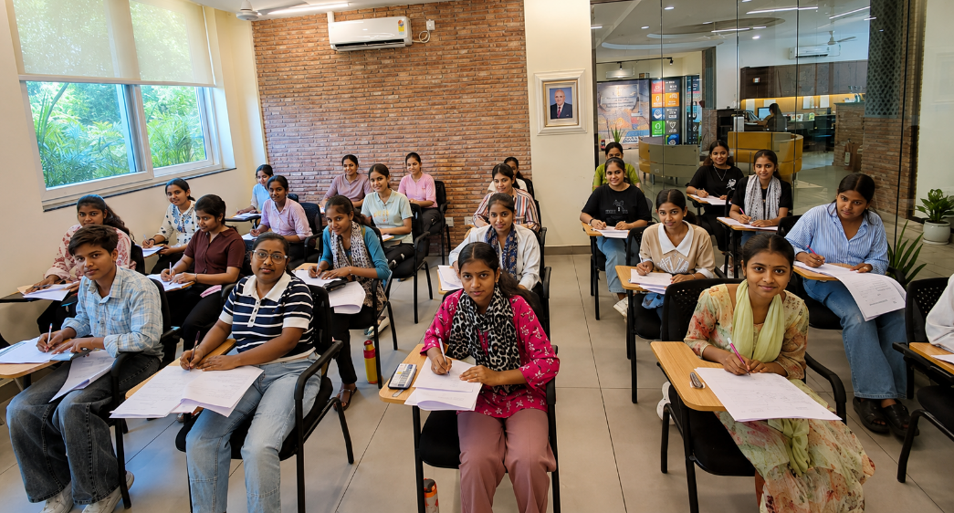
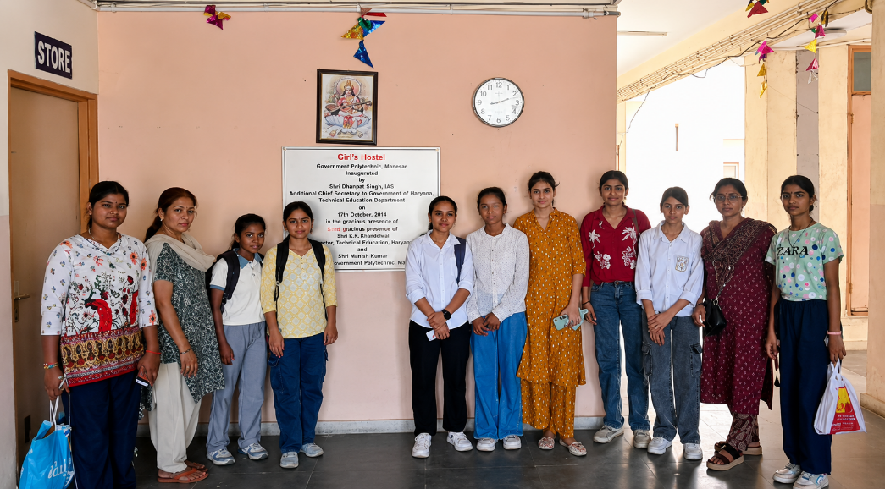
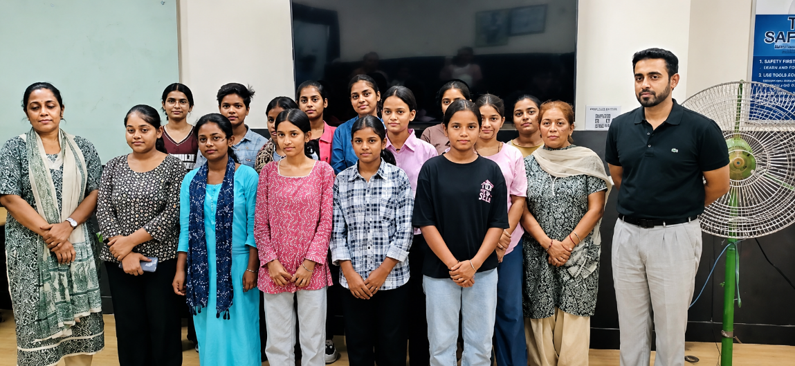
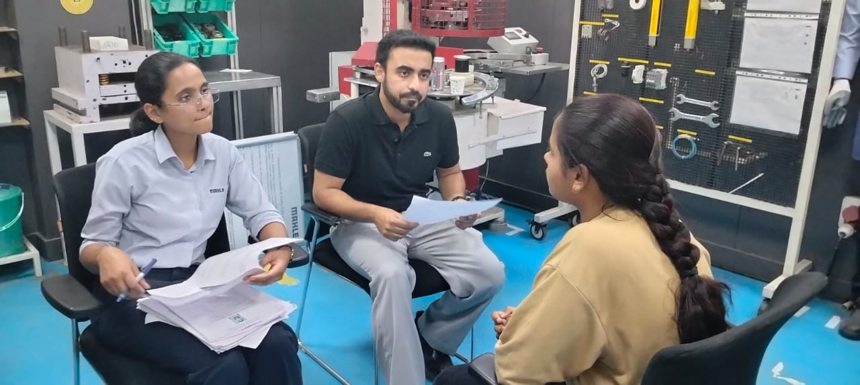
Gurugram: Glimpses from the Selection Process of Medhavi Scholarship Programme Supporting Girls To Pursue Dip. Engg.
18th May ‘26
MAFS started supporting SNSF’s Medhavi Scholarship Programme at Govt. Polytechnic, Manesar from 2024–25.
Currently, 13 Medhavi Scholars are pursuing their diploma at Govt. Polytechnic, Manesar.
For F.Y. 2026–27, 10 new Medhavi Scholars are in the process of being selected – written test completed on 18th May’26.
As part of the selection process, shortlisted candidates from written test attended interviews at MAFS, Khandsa, conducted by the MAFS HR.
Applicants appearing for the entrance test to Medhavi Scholarship 2026 -27 at SNSF Gurugram
Applicants also visited Govt. Polytechnic Manesar to see the facilities
21st May ‘26
14 students visited MAFS, Khandsa for interviews & also interacted with Divya Akhouri, Plant HR Head & Central OE Lead
Applicnat interview by Mantasha, Management Trainee &
Kunal Bidla, Assistant Manager at MAFS, Khandsa Plant

Slide 4
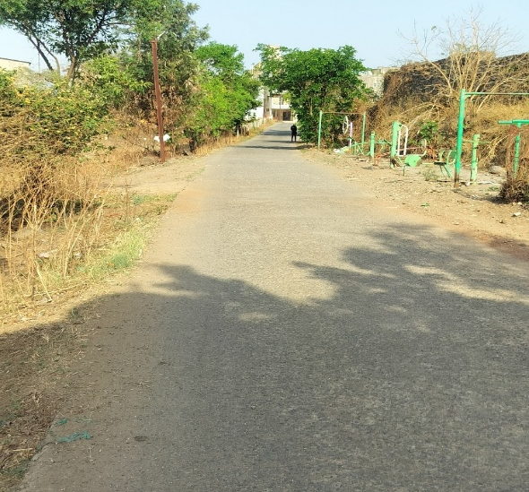
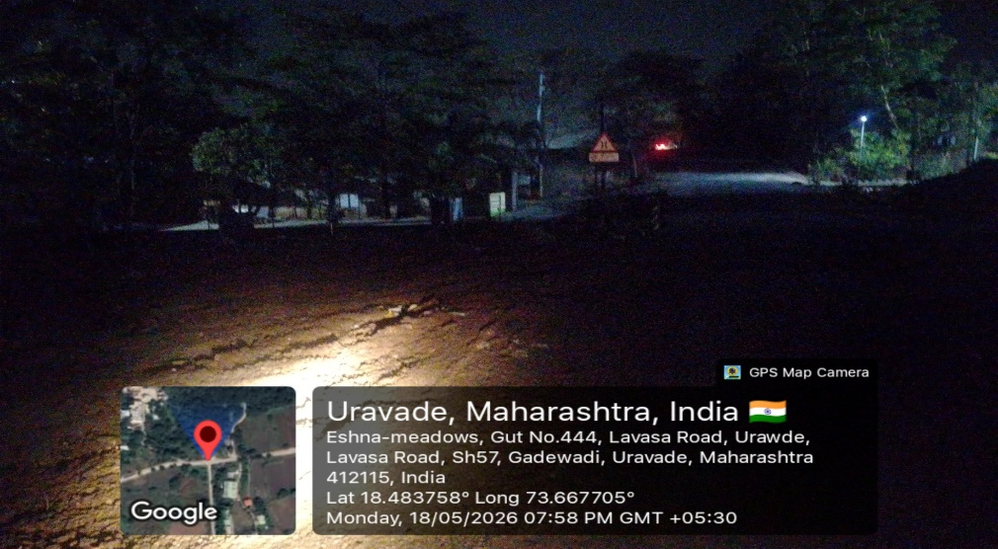
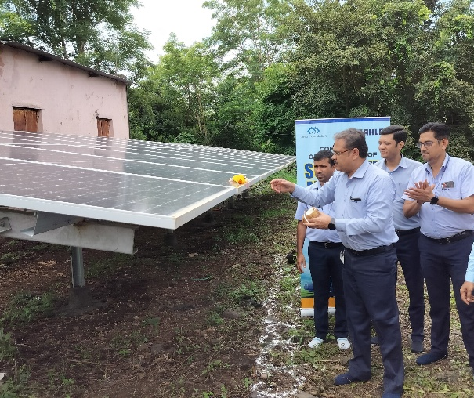
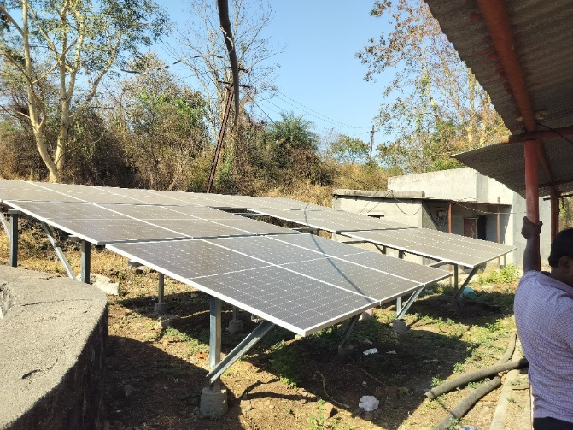
Pirangut (Pune): Installation of Solar Street Lights on the Approach Road and Internal Roads at Village Urawade
• Phase I (2023–24): SNSF & MAFS installed a 15 kW solar net metering system at Urawade village with 28 panels of 540 W each to reduce electricity costs associated with operating water pumps for drinking water distribution resulting in 22% savings (₹15K/month).
• Phase II (2024–25):
The system capacity was expanded from 15 kW to 27 kW, increasing overall electricity cost savings to 40% (₹25K/month).
F.Y. 2023-24 : Solar net metering (15 Kw) 1st Phase
Vill. Approach road
Vill. Internal road during night time
Urawade Village, with a population of 5,500, faces inadequate street lighting on its internal roads and the approach road connecting to Paud Road. Nearly 60% of residents work in the nearby Pirangut MIDC.
Between Aug '24 and Feb '25, the village reported four theft incidents and three road accidents, including one pedestrian fatality, raising safety concerns during night hours. Further, street lights installed by the Gram Panchayat are non-functional as the electricity connection was disconnected by MSEB due to non-payment of bills. Hence, installation of solar street lights on the approach and internal roads of Urawade village is proposed to improve night-time safety and visibility.
Reference : https://www.esakal.com/pune/todays-latest-district-marathi-news-prg24b01893-txt-pd-today-20240828041547
F.Y. 2024-25 : Solar net metering (12 Kw) 2nd Phase

Slide 5
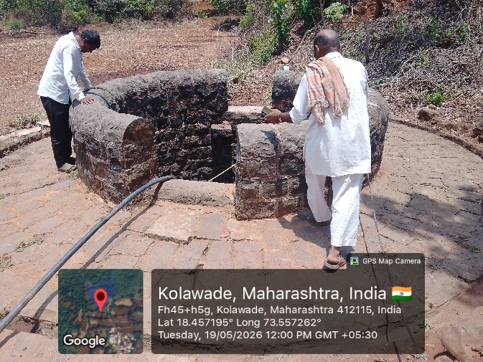
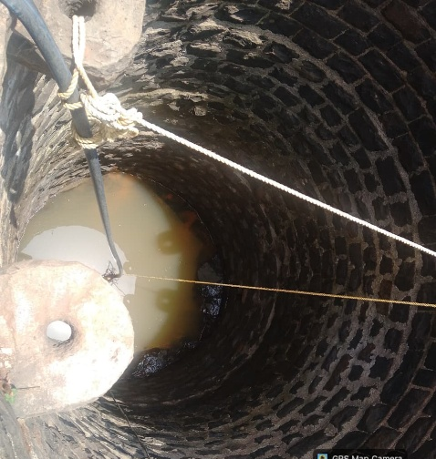
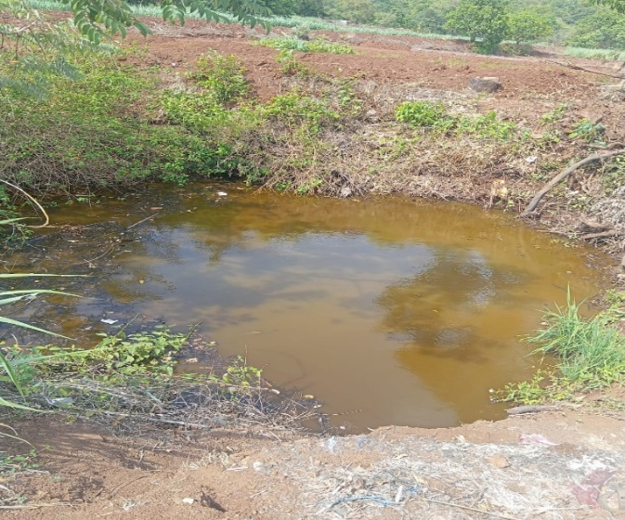



Pirangut (Pune): Enhance Access To Drinking Water for 100+ Families of Village Kolawade
Background :
Kolawade Village, located about 17 km from MAFS, Pirangut, has a population of 963. Nearly 80% of the families are engaged in farming.
The village comprises four hamlets and currently has only one well, which serves as the primary source of drinking water for all the hamlets and the main village.
Water is lifted from the well and supplied to the overhead tanks at the Kolawade main village and its hamlets thru pipeline network
Problem Statement: Village residents face the following key challenges:
Inadequate drinking water supply from the existing well.
Water levels decline from February and become critical during summer.
Turbid water at the bottom of the well is unsuitable for consumption.
Residents travel 2.5–3 km to collect water from neighbouring villages or the Mutha river
Existing drinking water well with turbid water
Potential Impacts
20’
50’
1 K
250
500
Proposed Intervention:
To address these challenges, construction of a new well is proposed at Kolawade village to provide an additional and reliable source of clean drinking water. The project also includes provision of a safety grating and pulley mechanism to ensure safe and convenient water extraction.
Humans in Village
Cattles in Village
KL
Water
Storage
Proposed site for construction of well

Slide 6
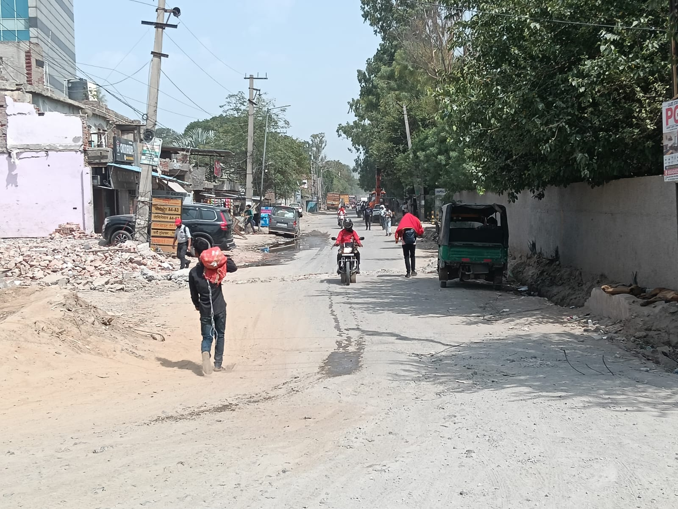
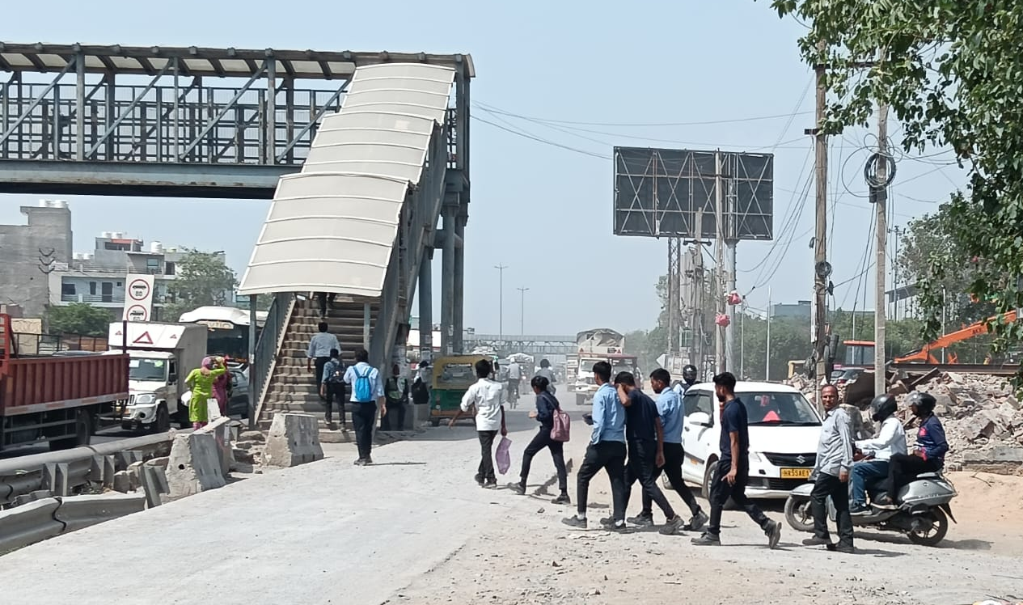
Construction of Pedestrian Walkway at Behrampur Road and Refurbishment of Foot-over Bridge
Pedestrian Walkway requirement
Foot-over Bridge requirement

Slide 7
Thank You

